Slide 1

Exploratory Data Analysis
Cab Investment Firm
Hassan Faheem
16/02/2022

Slide 2

Agenda
Executive Summary
Data Exploration
EDA
Conclusion

Slide 3
Executive Summary
Company Background
XYZ is a private firm in US. Due to remarkable growth in the Cab Industry in last few years and multiple key players in the market, it is planning for an investment in Cab industry and as per their Go-to-Market(G2M) strategy they want to understand the market before taking final decision.
Objective
To find which of the Companies is more suitable for Investment.
To find the Company that is more successful considering various factors
Process
The Dataset will be Analyzed and combined into one. Then Exploratory Data Analysis Techniques will be performed & Visualizations will be used to Identity for the better Company.

Slide 4
Data Exploration
Overview of Each Dataset
Assumptions
• Data Sources are merged on Customer ID, Transaction ID & City.
• There are outliers present in the feature Price Charged but they cannot be treated as outliers due to insufficient information for Trip Duration.
• The features of Price Charged & Cost of Trip are used for the calculation of Profit.
• The feature of Users in the dataset of City are assumed to be cab users of all cab companies including Yellow & Pink Cab Companies.
Name | Number of Features | Observations
Cab Data | 7 | 359393
City | 4 | 21
Customer ID | 4 | 49172
Transaction ID | 3 | 440099

Slide 5
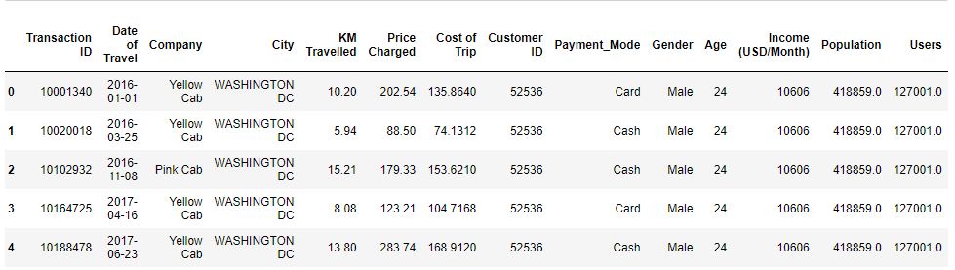
Data Exploration
Overview of Combined Dataset

Slide 6

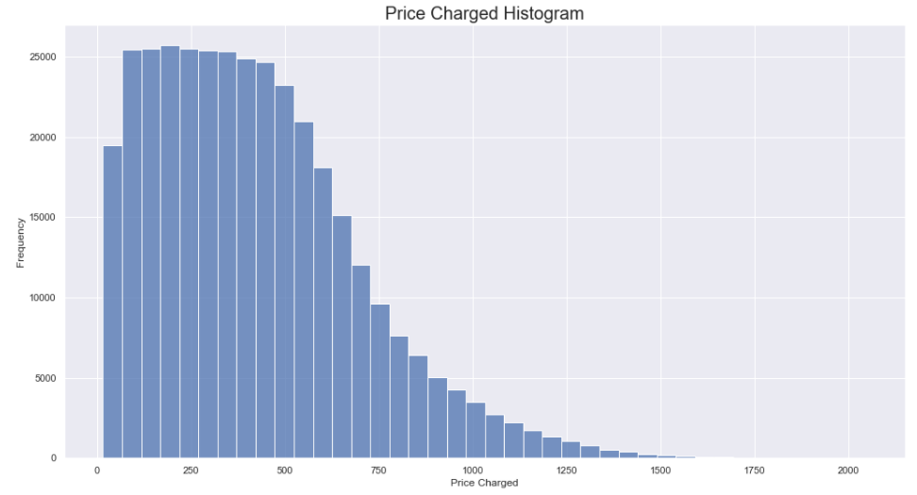
Analysis of Features
Analysis of KM Travelled & Price Charged

Slide 7
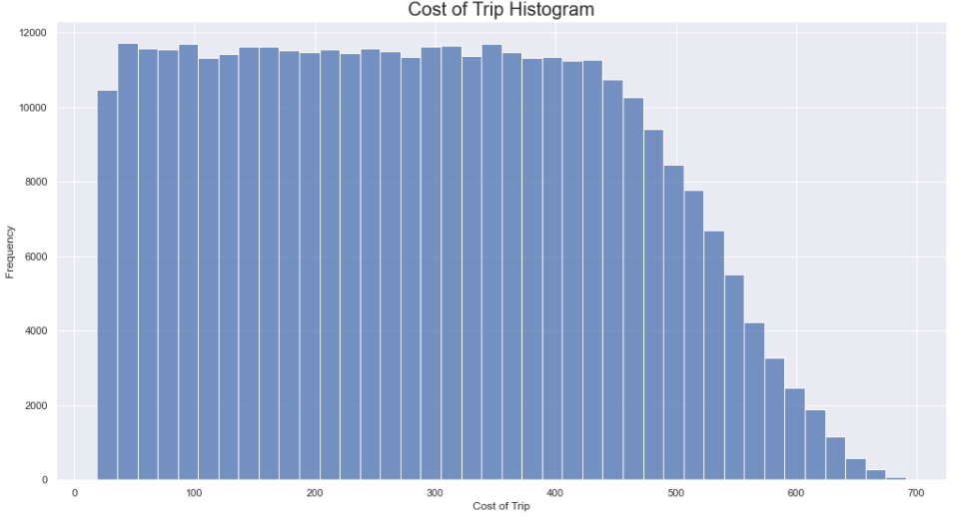
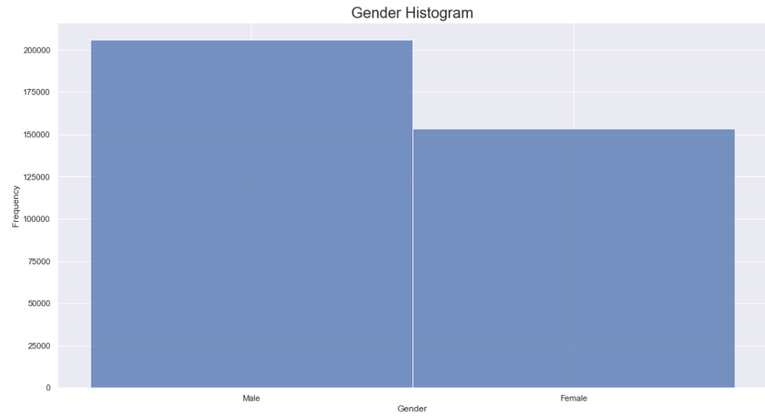
Analysis of Features
Analysis of Cost of Trip & Gender

Slide 8
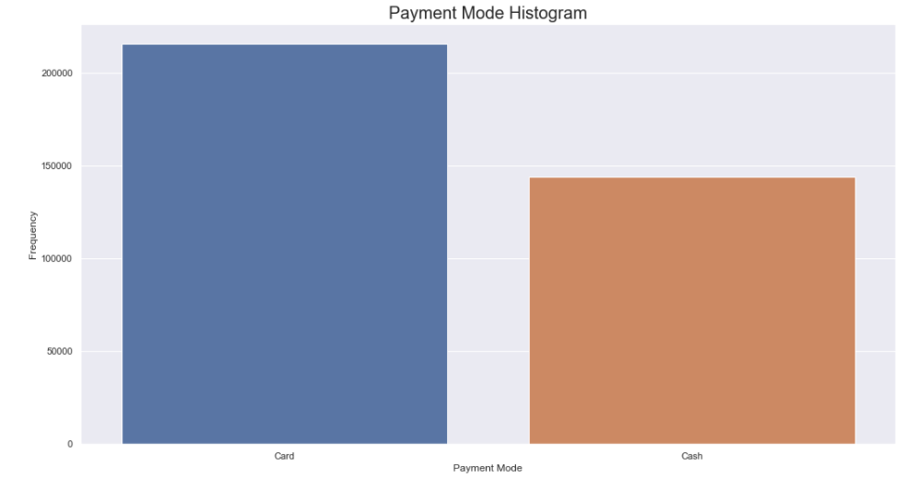
Analysis of Features
Analysis of Payment Mode

Slide 9
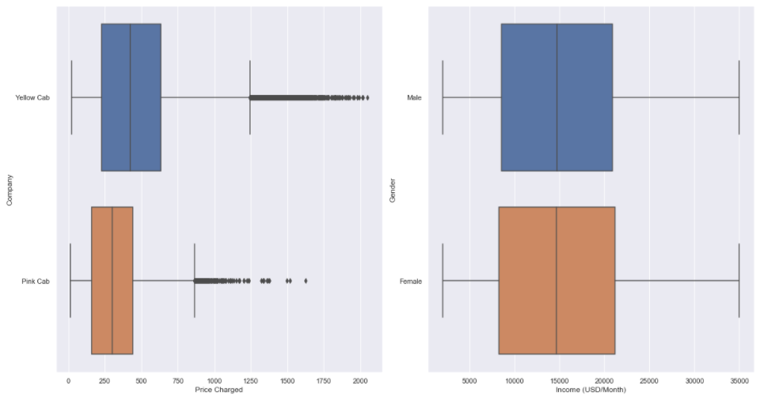
Outliers
There are outliers present in the feature Price Charged but they cannot be treated as outliers due to insufficient information for Trip Duration.

Slide 10
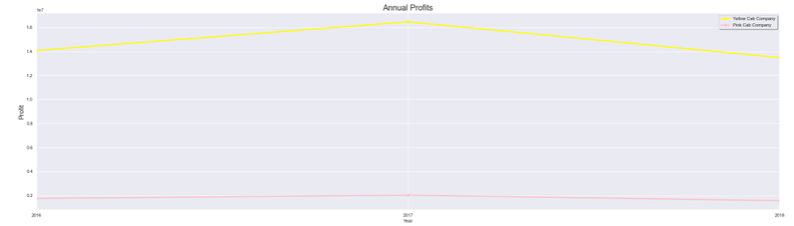
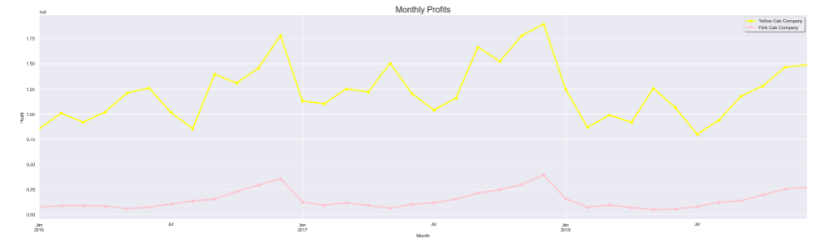
Analyzing Profits
Yearly & Monthly Profits

Slide 11
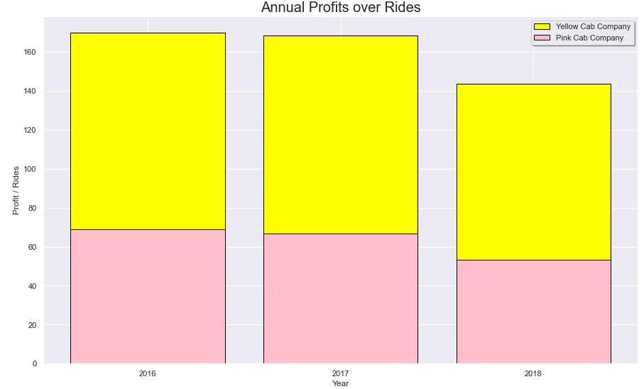
Analyzing Profits
Profits over the years

Slide 12
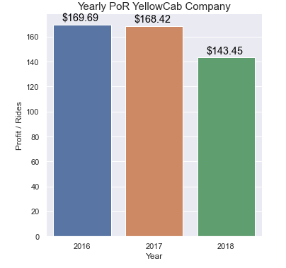
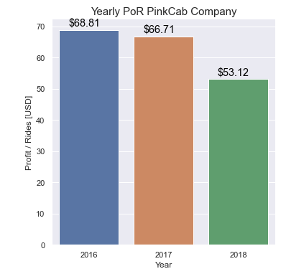
Analyzing Profits
Yearly ROI of Yellow & Pink Cab Companies

Slide 13
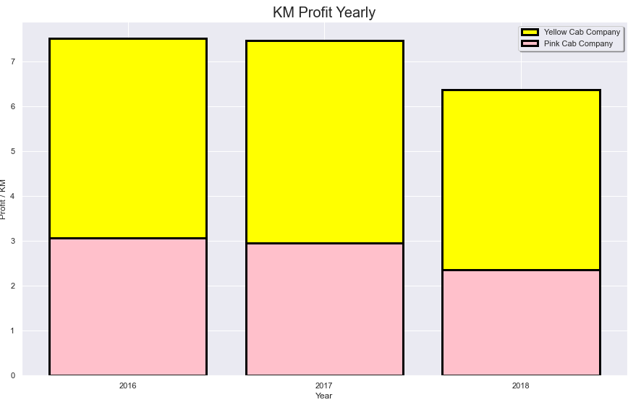
Analyzing Profits
KM Profit of each Cab Company shows better returns by Yellow Cab Company

Slide 14
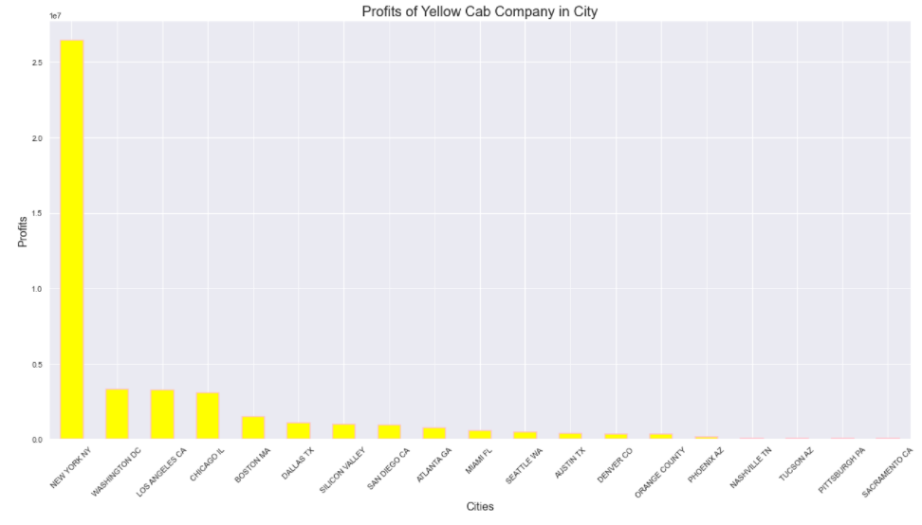
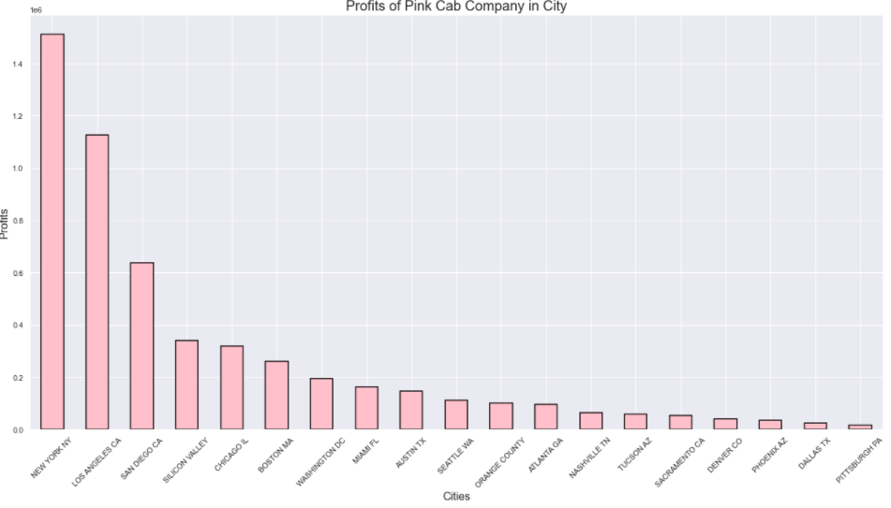
Analyzing Profits
Profits of Each Cab Company in Various Cities

Slide 15
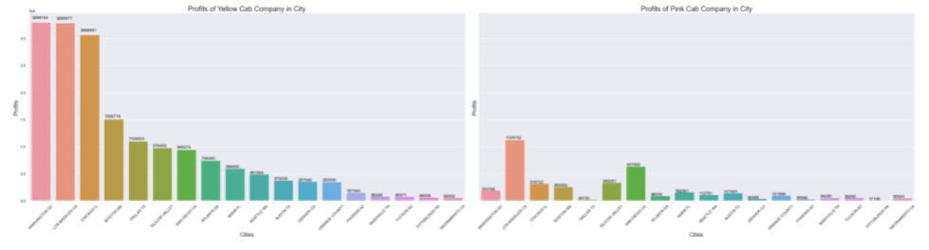
Analyzing Profits

Slide 16
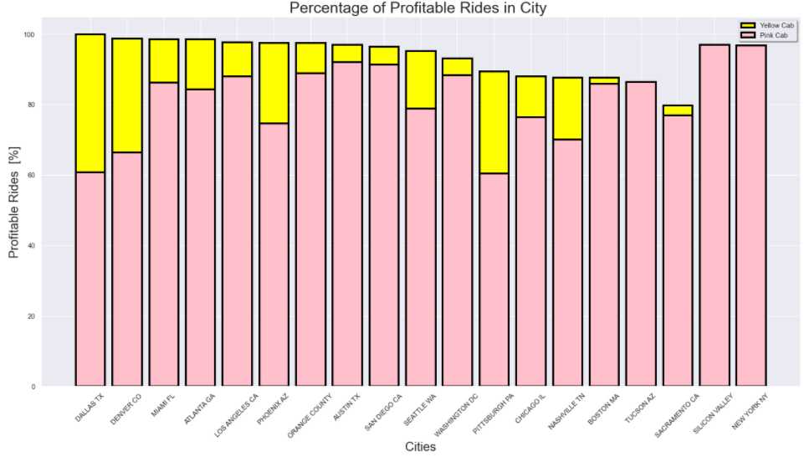
Analyzing Profits

Slide 17
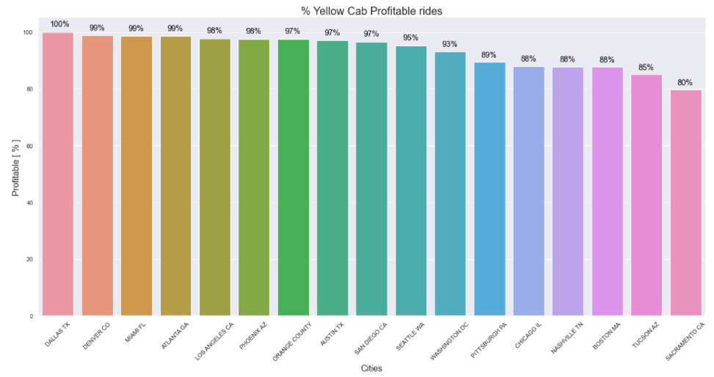
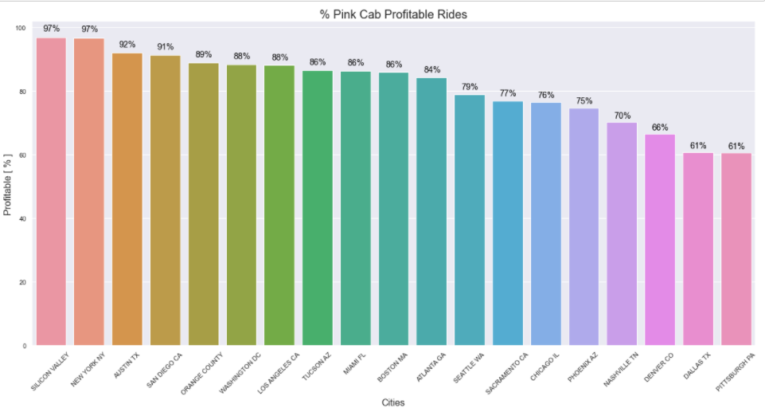
Analyzing Profits
Yellow Cab Company has more % of Profitable Rides

Slide 18
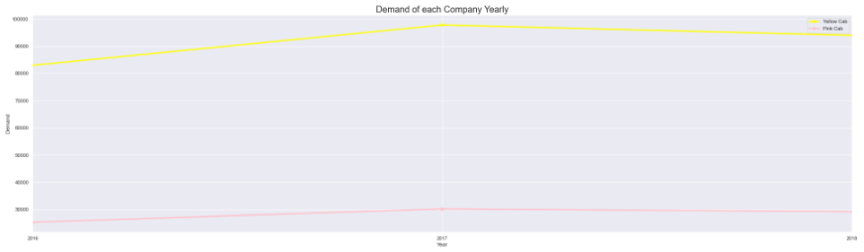
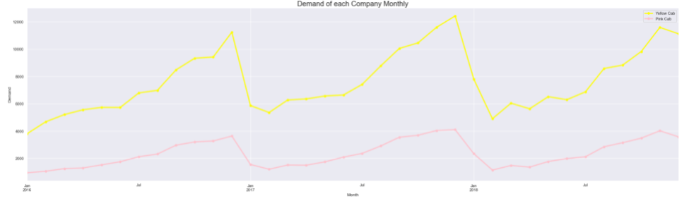
Analyzing Demand
Yearly & Monthly Demand of each Cab Company

Slide 19
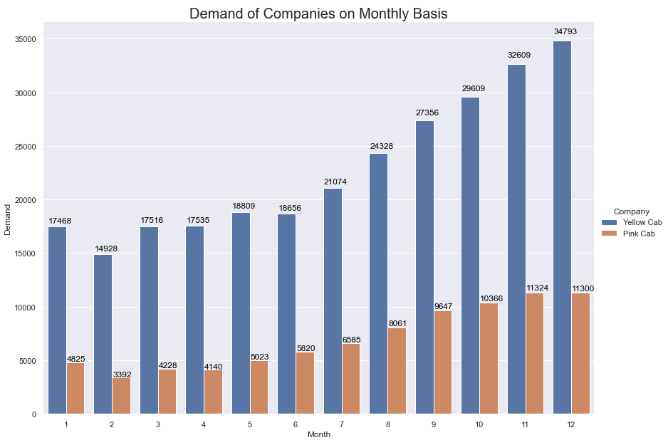
Analyzing Demand
Higher Demand for Yellow Cab Company

Slide 20
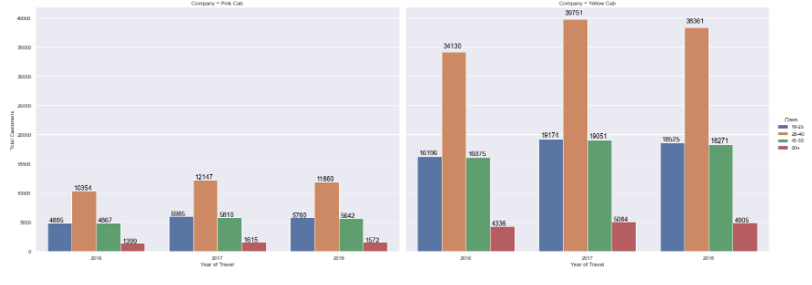
Analyzing Demand
Yellow Cab Company in More Demand based on Age Factor

Slide 21
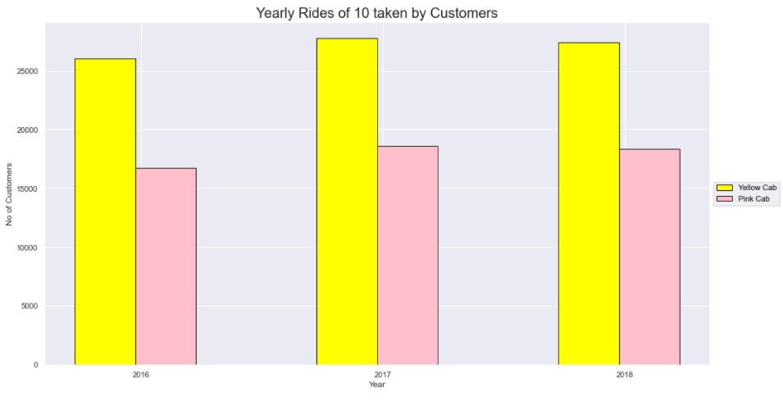
Analyzing Customers
Yellow Cab Company has more Customers that have taken 10 rides yearly

Slide 22
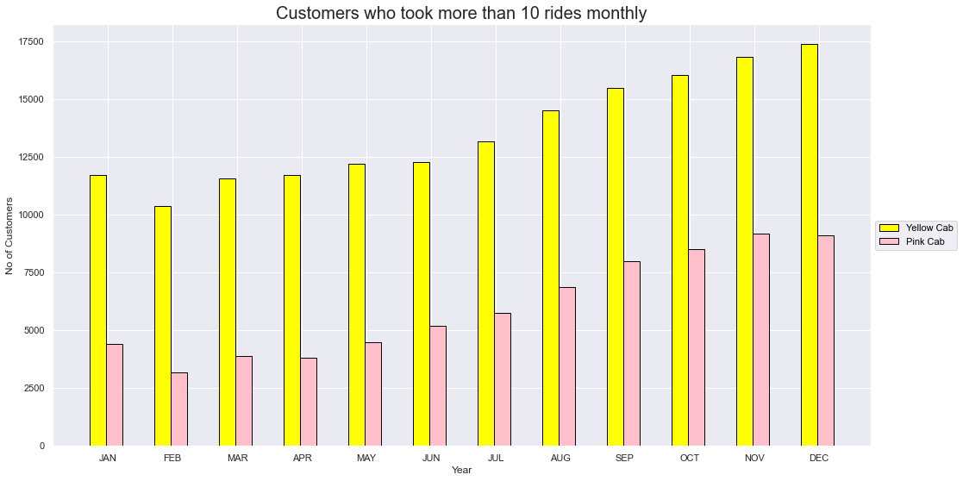
Analyzing Customers

Slide 23
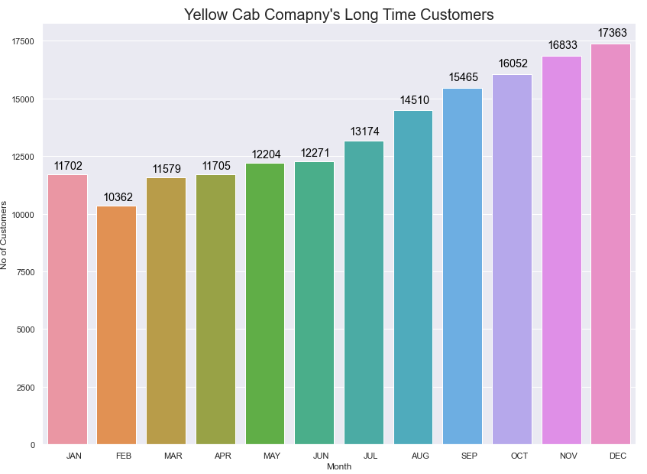
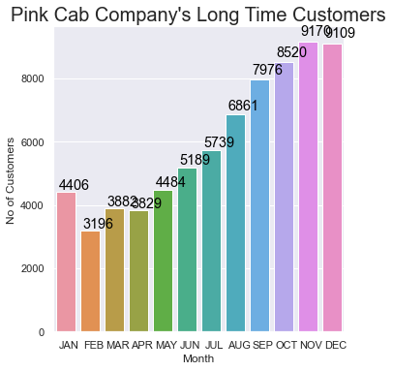
Analyzing Customers
Long Time Customers for each of the Cab Company

Slide 24
Conclusion
Both the Cab Companies were Analyzed based on Profits, Demand & Customers. The following shows the results of the analysis
Profit
Both Cab Companies showed Profits that have increased with time
Profits in terms of City & Rides, Yellow Cab Company has performed better in each of the category.
Demand
The demand for Yellow Cab Company is far Greater than Pink Cab Company
Both of the Companies are used by similar Age Groups
Customer
Yellow Cab Company has more long term customers who have taken more Rides Yearly & Monthly
Conclusion: Yellow Cab Company is overall better in every aspect and is thus a better company for investment.

Slide 25
Thank You

